Slide 1
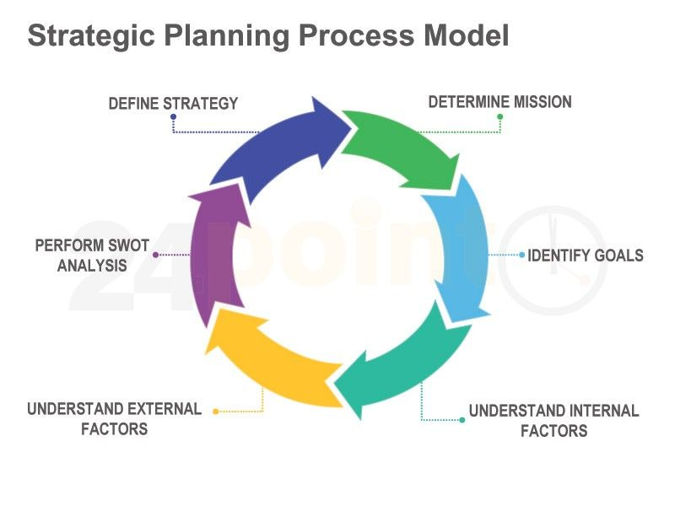
strategic planning process in Stevens District Hospital
Notes:
Stevens District Hospital intends to engage in strategic planning that clearly defines objectives and assess both internal and external situation to formulate strategy as well as the role the radiology department can play in increasing business for the hospital.

Slide 2
The purpose of a strategic plan
The strategic plan aims to define the priorities of the radiology department at Stevens District Hospital, with a specific focus on the vision and strategic objectives
The strategic plan shall work towards achieving several goals and objectives
Notes:
The strategic plan aims to define the priorities of the radiology department at Stevens District Hospital, with a specific focus on the vision and strategic objectives. This strategic plan is designed to guide the radiology department for the next four years. The implementation of this plan will provide considerable value to radiologists in the Stevens District Hospital in several ways. Most significantly, it will provide the opportunity to create initiatives that assist each member’s ability to practice their profession at their highest level; it will also enhance radiologists’ ability to deliver the highest levels of patient care.
The strategic plan shall work towards achieving several goals and objectives. Some of these goals and objectives include; strengthening hospital relationship, providing excellence and safety in Imaging delivery and care, growing our imaging research to the elite top 5 on the regional level, recruitment and retention of an outstanding and diverse faculty and staff including building the needed infrastructure for practice quality improvement.

Slide 3
A strategic plan should align with the mission and vision statements
A strategic plan should align tightly with the mission and vision statements of the hospital in order to avoid challenges in achieving goals.
The strategic plan’s vision shall align with the vision of the Radiology Department in order to mutually articulate towards realizing of the objectives and goals
Notes:
This strategic plan is intended to align with Stevens District Hospital mission and vision statements. The hospital’s mission is to focus on achieving clinical excellence. In the current healthcare spectrum of the hospital, it is equally important that the mission of the radiology department be aligned tightly with their hospital and organizational partners to avoid challenges in achieving goals (Alam, & Alabdulaali, 2015).
Consequently, the strategic plan’s vision shall align with the vision of the Radiology Department. According to Ebener & Smith(2015), a vision statement is an ultimate purpose on which the organization focuses for the long term, and it is never wholly accomplished. Thus, a vision statement guides stakeholders in working toward the mission and to incessantly move closer to achieving the standards voiced in the vision (Gulati, Mikhail, Morgan & Sittig, 2016). It is in this reason that the strategic plan’s vision shall serve as a mutual purpose that enhances the alignment of all radiology department staffs and patients in an articulated direction toward realizing the mission of the Radiology Department.

Slide 4
A strategic plan should align with the mission and vision statements cont.
Failure to align the strategic plan with a clear vision statement, leaders, employees, patients, and all other stakeholders will be unable to identify where the department is headed.
A clear defined mission and vision statements will enhance a close personal connection and sense of purpose that will compel departmental members to appropriately focus their potential energy
Notes:
Clearly defined mission and vision statements shall be substantial for the radiology department on a wide scale. This is because failure to align the strategic plan with a clear vision statement, leaders, employees, patients, and all other stakeholders will be unable to identify where the department is headed. A clear defined mission and vision statements will enhance a close personal connection and sense of purpose that will compel departmental members to appropriately focus their potential energy (Rentes et al. 2019). A mission and vision statements for the strategic plan of the Radiology Department shall focus on the department’s aspirations to improve health, longevity, satisfaction, and well-being for all patients, among other expectations.

Slide 5
Importance of multiple stakeholders to the strategic planning process
Involvement of concerned stakeholders shall help in identifying public concerns and values and developing a broad consensus on planned initiatives
Multiple stakeholder engagement is essential for building commitment; which is an increasingly important element of the strategic planning process.
Notes:
In this strategic planning process, it shall be important to engage in multiple stakeholder engagement. Involvement of concerned stakeholders shall help in identifying public concerns and values and developing a broad consensus on planned initiatives. This means the participation of all the stakeholders will be vital in ensuring focus and commitment to mission and vision statements of the Stevens District Hospital. Bryson (2018) asserts an organization or a department can have a blueprint of a strategic planning process, however, what differentiates a good performing entity from a poor performing entity is the inclusivity of strategic plans. Inclusivity fosters commitment. Hence, without commitment, it is challenging to ensure that the hospital’s stakeholders will move in the direction they need to go to achieve expected outcomes. In this perspective, multiple stakeholder engagement is essential for building commitment; which is an increasingly important element of the strategic planning process (Andriof, Waddock, Husted & Rahman, 2017).

Slide 6
Importance of multiple stakeholders to the strategic planning process
The influence and power of a stakeholder can affect the success or failure of this strategic planning initiative.
Engaging multiple stakeholders fosters greater understanding which eventually leads to greater ownership
Notes:
The influence and power of a stakeholder can affect the success or failure of this strategic planning initiative. A stakeholder’s power can be significant in terms of supporting as well as in terms of constraining an initiative. Concerning failures, the Radiology Department must know the potential negative influence a stakeholder has to constrain or even halt an initiative. Also, it is very vital to know whether and how a stakeholder can take action, how he/she can be involved, and how much capacity he/she has to contribute for the success of the strategic planning initiative. The balance can be realized if there is multiple stakeholder inclusion in discussions for strategic planning to the greatest extent possible. Moreover, greater understanding leads to greater ownership. To foster this ownership, there should be effective communication to and fro for constant reinforcement of the shared ideas as well for providing feedback on how ideas are being integrated into the process (Ciarmiello & Hinna, 2016).

Slide 7
All stakeholders that are involved in the strategic planning process.
Both internal and external stakeholders shall be involved in the strategic planning process
The internal stakeholders are those groups which belong inside Stevens District Hospital such as radiologists, patients, referring physicians.
External stakeholders are groups that are outside the Stevens District Hospital. They include providers and community at large
Notes:
In this project, stakeholders are people who have an interest in Stevens District Hospital that operate within the hospital's environment either internally or externally. Both internal and external stakeholders have distinctive perception about what it will take for the Stevens District Hospital to prosper. In the strategic planning process internal stakeholders are accustomed with the strengths and weakness of the Stevens District Hospital and regularly have an understanding of the approaches that should be taken for the hospital to realize better performance. On the other hand, in the initial periods of planning, outside stakeholder’s ideas and understanding because they have an understanding of environmental operations as well as the visualization of the Stevens District Hospital’s forthcoming ((Ciarmiello & Hinna, 2016).
The internal stakeholders are those groups which belong inside Stevens District Hospital, such as radiologists, patients, referring physicians. External stakeholders are groups that are outside the Stevens District Hospital and have effects on the survival of the hospital. These include providers and community at large.

Slide 8
Consider each stakeholder’s position and level of decision-making.
Physicians are key stakeholders in this strategic planning process as they are the one tasked to deliver better, more effective care and manage to quality metrics.
Departmental staffs in the planning process help in building ownership within the hospital and also they are key implementers of the strategic plan
Notes:
Physicians
Physicians are key stakeholders in this strategic planning process as they are the one tasked to deliver better, more effective care and manage to quality metrics. Physicians are in an excellent position to identify how to deliver reliable outcomes and lower costs.
Integrating physicians into the decision-making process and providing feedback on their ideas will be significant largely because they are deeply invested in delivering better care to patients and shaping their work environment in positive ways (Sharpe Jr, Mehta, Eisenberg & Kruskal, 2015).. As such, physicians should be directly in the strategic planning process through broad physician representation since they are in an excellent position to identify how to deliver that value.
Radiologists
Departmental staffs in the planning process help in building ownership within the hospital. Radiologists who do not understand the strategic plan will highly likely have a difficult time remaining engaged and moving in the desired direction.
The departmental staffs/ radiologists shall be the implementers of the strategic plan, hence, it will be nearly impossible to achieve the mission of the strategic plan without the commitment of the staffs. In this case, department meetings should take a central role in soliciting input on the plan and its results.

Slide 9
Consider each stakeholder’s position and level of decision-making.
During the strategic planning process, it is essential to identify with clients based on what they can expect
Providers should be involved during a strategic planning process to achieve early buy-in to the program.
Working collaboratively with and through groups of people affiliated by special interest, geographic proximity, or alike circumstances it will be easier to address concerns impacting their well-being.
Notes:
Patients/clients
It is essential to identify with clients based on what they can expect during the strategic planning process. Patients should be segregated either by demographic or by socioeconomic in order to collect a wide spectrum of what patient's expectation concerning strategic planning.
Providers
Providers should be involved during a strategic planning process to achieve early buy-in to the program. They hold the position of providing decisions regarding feedback on program interventions, guidelines, measures, and strategies.
Community
These stakeholders are key to the strategic planning process. This is because by working collaboratively with and through groups of people affiliated by special interest, geographic proximity, or alike circumstances it will be easier to address concerns affecting the well‐being of those people.

Slide 10
the purpose of a communication plan in the strategic planning process.
A communication plan is fundamental for sharing information purposefully and consistently.
A communication plan helps internal stakeholders in knowing where the hospital is going so they can align their work with those goals and direction
A communication plan is used for sharing the results the stakeholders have achieved including serving as a means to coaching them toward strategic performance.
Notes:
To build and support ongoing engagement in the strategic planning and implementation process, a communication plan is fundamental for sharing information purposefully and consistently. Communication Plan will integrate the communication strategies necessary to achieve the results across stakeholders. To engage all key stakeholders a communication plan is a significant approach to help them in knowing the strategic plan’s core purpose (Bütschi, 2018).
A communication plan helps internal stakeholders in knowing where the hospital is going so they can align their work with those goals and direction. Similarly, a communication plan helps external stakeholders to understand why the hospital exists and what value it provides for the populace of Jefferson City.
To make sure shareholder engagement is realized, the communication should utilize all communication means available such as memos, electronic messaging, newsletters, posters, meetings, e-mail, payroll inserts among others. The communication plan should be reliable and consistent and work towards showing how stakeholders fit into the plan and how their contributions would help shape the choices made. Also, the communication plan should be used for sharing the results they have achieved including serving as a means to coaching them toward strategic performance (Bütschi, 2018).

Slide 11
References
Alam, A. Y., & Alabdulaali, M. K. (2015). Hospital vision and mission strategic planning and departmental performance. The Journal of the Pakistan Medical Association, 65(4), 345-346.
Andriof, J., Waddock, S., Husted, B., & Rahman, S. S. (2017). Unfolding stakeholder thinking: Theory, responsibility and engagement. Routledge.
Bryson, J. M. (2018). Strategic planning for public and nonprofit organizations: A guide to strengthening and sustaining organizational achievement. John Wiley & Sons.
Bütschi, G. (2018). Communication Planning. The International Encyclopedia of Strategic Communication, 1-11.
Ciarmiello, A., & Hinna, L. (2016). SWOT Analysis and Stakeholder Engagement for Comparative Evaluation of Hybrid Molecular Imaging Modalities. In PET-CT and PET-MRI in Neurology (pp. 271-282). Springer, Cham.
Ebener, D. R., & Smith, F. L. (2015). Strategic Planning : An Interactive Process for Leaders. New York: Paulist Press. Retrieved from http://search.ebscohost.com/login.aspx?direct=true&db=nlebk&AN=1155271&site=eds-live
Gulati, R., Mikhail, O., Morgan, R. O., & Sittig, D. F. (2016). Vision statement quality and organizational performance in US hospitals. Journal of Healthcare Management, 61(5), 335-350.
Rentes, V. C., de Pádua, S. I. D., Coelho, E. B., Cintra, M. A. D. C. T., Ilana, G. G. F., & Rozenfeld, H. (2019). Implementation of a strategic planning process oriented towards promoting business process management (BPM) at a clinical research centre (CRC). Business Process Management Journal.
Sharpe Jr, R. E., Mehta, T. S., Eisenberg, R. L., & Kruskal, J. B. (2015). Strategic planning and radiology practice management in the new health care environment. Radiographics, 35(1), 239-253.

